Slide 1

Manage Modern Applications Using AWS Fargate
By:
Abburi Venkata Praveen

Slide 2
Services:
Cloud 9 IDE
S3 Bucket
Micro service
AWS Fargate
Cloud Formation stack
Fargate Cluster
Cloud watch logs
ECS
Load balancer
Docker

Slide 3
Aim : To Manage and host a static website in s3 and host API backend microservice deployed as a container using AWS Fargate server
Cloud 9 :
Cloud9 is an IDE which is used to manage code and debug code.
It has in built in web browser.
We used this service for executing of commands and manage the web and dynamic applications.
S3 Bucket :
S3 can be used to store and manage the applications.
In our project we are using s3 bucket to host a static website.
Micro service:
Is an architectural style that structures as a collection of services such as highly maintainable.
In our project we are hosting a micro service on AWS Fargte and access through the Network Load balancer

Slide 4
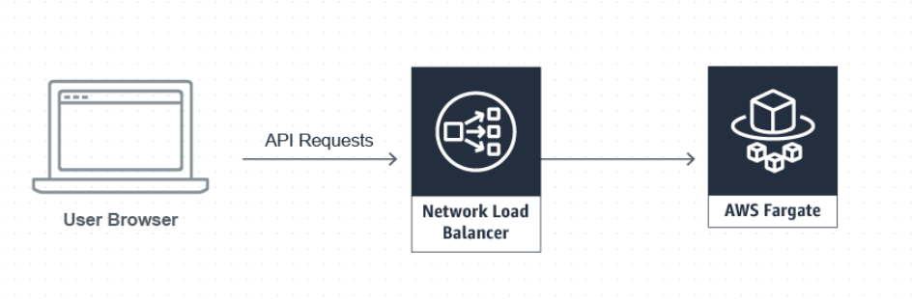
AWS Fargate:
AWS Fargate: It is a deployment option in ECS that allows container deployment without the need to manage the cluster or server.
Another deployment option is AWS Lambda-good for real-time data
Why we chose Fargate :
Best choice for long-running processes such as microservices backends for web and mobile and PaaS platforms.
Fully integrates with AWS services
Full control of network and security services

Slide 5
Docker & Fargate Cluster
Docker image consist of system libraries, tools, other files and dependencies for the execution of code.
Docker comes automatically with installation of Cloud9 IDE.
Docker image we can built with our account id for sample purpose.
we can check the service by running docker locally in cloud9 IDE.
Push the image into ECR for storing these images in Repository.
Fargate Cluster:
Fargate cluster is used to manage the multiple servers and service containers.
Fargate used to deploy the containers into cluster without managing the servers.
Docker Image:

Slide 6
Cloud Formation:
Templates used for reliable provisioning of stacks.
We can build infrastructure with cloud formation using YAML or JSON format.
With creation of cloudformation stack automatically create necessary network and security resources in core.yaml file.
It automatically create the NAT gateways, VPC & Security groups.
We used formation template to create the stack which can used to easy integration of Network loadbalancer.
will create templates for service and application architecture.

Slide 7
Other Services:
Cloud watch Logs: Cloud watch is a service which allows to manage the logs for analysis purpose.
ECS Task definition allows to configure the set of containers
NAT gateway: we use a network address translation (NAT) gateway to enable instances in a private subnet to connect to the internet or other AWS services.
IAM : IAM enable the feature of granting permission to the service.
Network Load balancer : Network load balancer is allows to expose our services over internet.
Listen port enable the communication end point from the server and browser.

Slide 8
Issues Faced:
Initially Creation of stacks created huge issue for starter account.
Deletion of stacks are very difficult because it is interlinked with many services.
Deletion of network Load balancers were big problem.

Slide 9
Steps
Cloud9 IDE For AWS CLI and mange the code.
Configure S3 bucket for hosting web site.
Create cloud formation template.
Build a dockerimage.
Create ECR Repository.
Push image into ECR Repository.
Create a cluster
Create AWS Cloud watch logs

Slide 10
Cont..
Register ECS Task definition
Create and configure Network Load Balancer
Grant permission to service
Trigger with DNS We can reach the our site.
We can observer logs flow in Cloud watch.

Slide 11
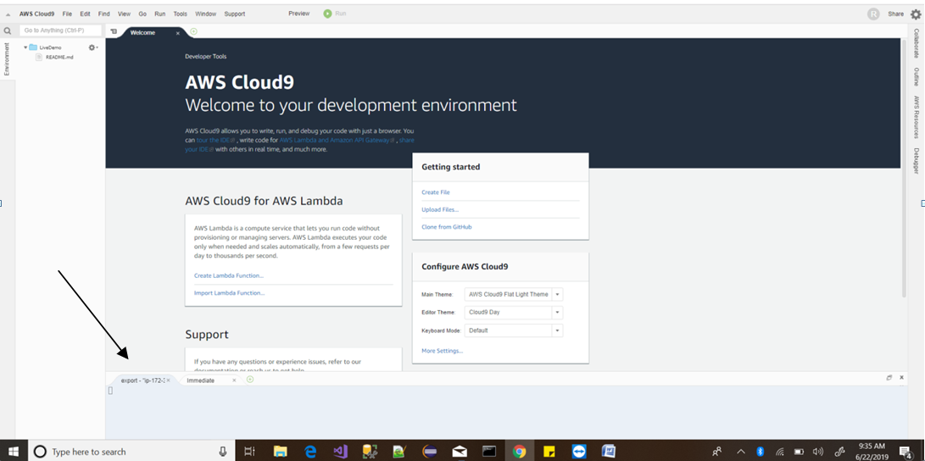
AWS Cloud9 IDE

Slide 12
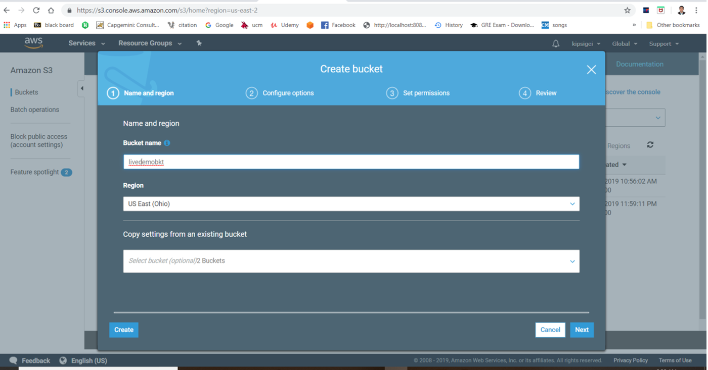
S3 Bucket creation

Slide 13
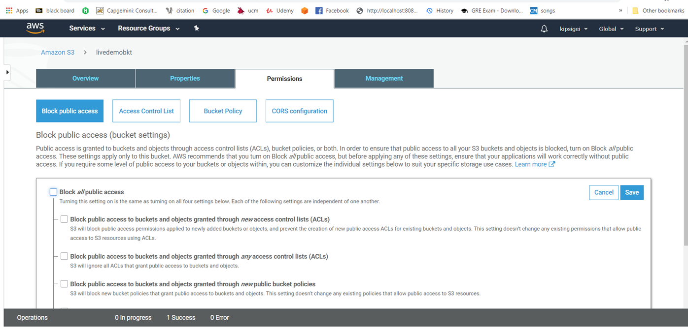
Allow Public Access to S3

Slide 14
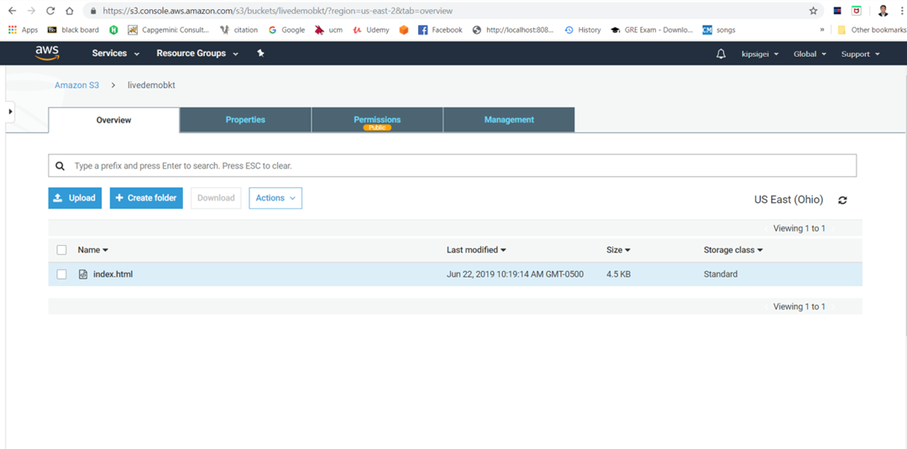
Static Website host with S3 bucket

Slide 15
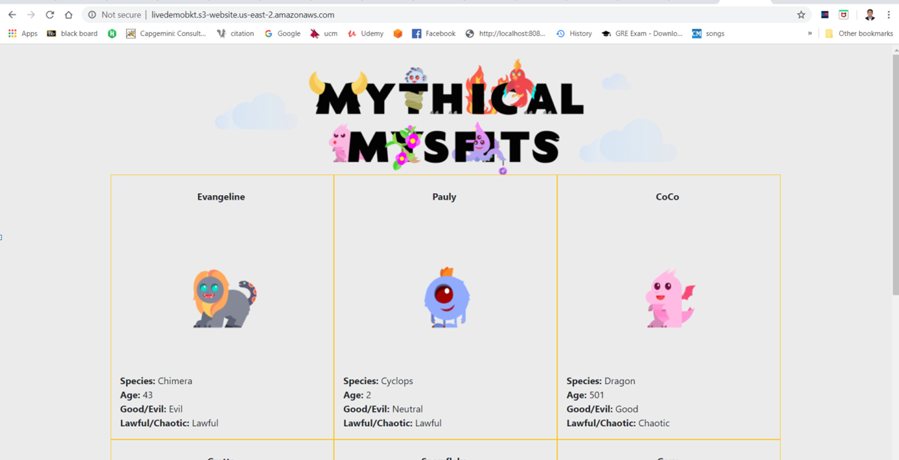
Static Website view

Slide 16
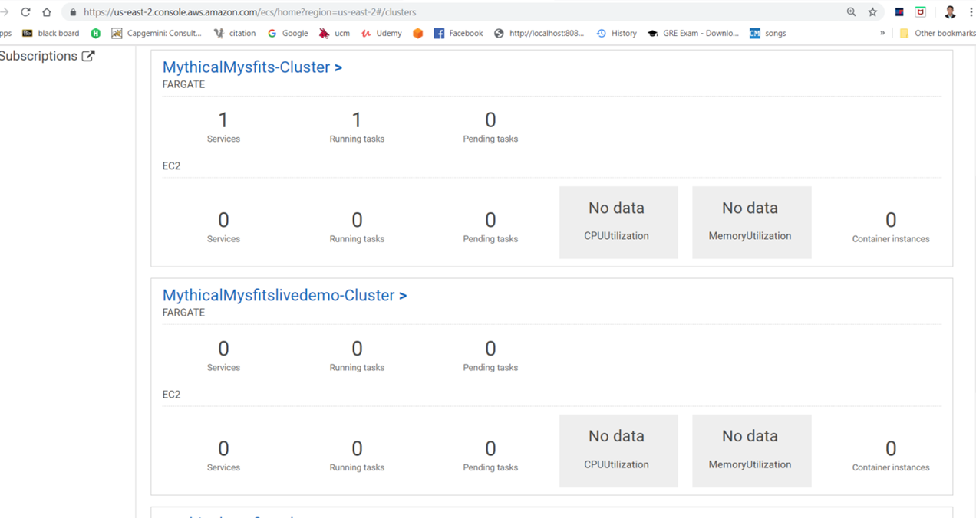
Fargate Cluster

Slide 17
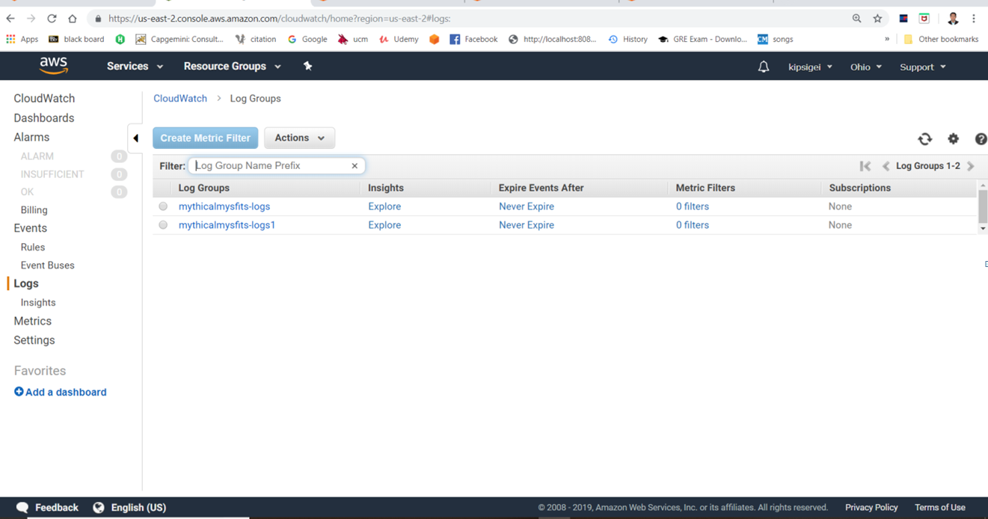
Cloud Watch console

Slide 18
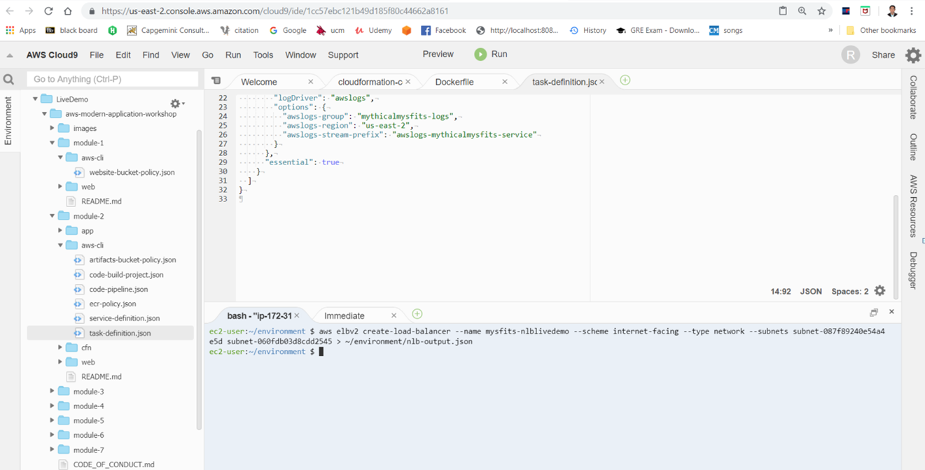
Creating NLB

Slide 19
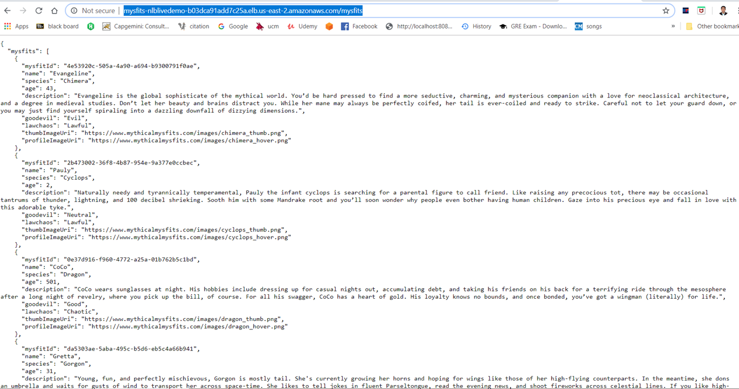
Hosted Micro service

Slide 20


